Slide 1
Dependency Injection
Submited by
Anuja Sathe

Slide 2
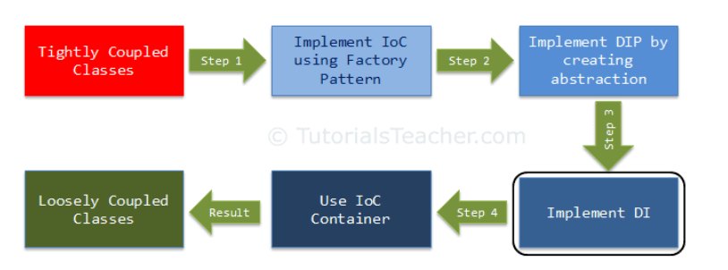
Dependency Injection

Slide 3
Dependency Injection (DI) is a design pattern used to implement IoC. It allows the creation of dependent objects outside of a class and provides those objects to a class through different ways. Using DI, we move the creation and binding of the dependent objects outside of the class that depends on them.
The Dependency Injection pattern involves 3 types of classes.
Client Class: The client class (dependent class) is a class which depends on the service class
Service Class: The service class (dependency) is a class that provides service to the client class.
Injector Class: The injector class injects the service class object into the client class.

Slide 4
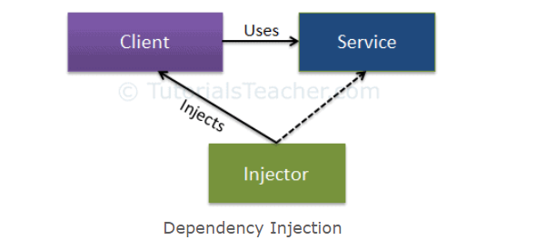
The following figure illustrates the relationship between these classes:
As you can see, the injector class creates an object of the service class, and injects that object to a client object. In this way, the DI pattern separates the responsibility of creating an object of the service class out of the client class.

Slide 5
Types of Dependency Injection
Constructor Injection:
In the constructor injection, the injector supplies the service (dependency) through the client class constructor.
Property Injection:
In the property injection (aka the Setter Injection), the injector supplies the dependency through a public property of the client class.
Method Injection:
In this type of injection, the client class implements an interface which declares the method(s) to supply the dependency and the injector uses this interface to supply the dependency to the client class.

Slide 6
Configure di
Asp.net core provides the built-in support to DI.
Dependency are registered in containers and the container in asp.net core is IServiceProvider.
Services are typically registered in the application’s Startup.ConfigureServices method.

Slide 7
Service lifetime
Transient(AddTransient< >):
a new instance of the services will be created every time it is requested.
Scoped(AddScoped<>):
These are created once per client requested.
Singleton(AddSingleton<>):
Same instance for Apllication

Slide 8
With the .NET Framework, we used to use containers like LightInject, NInject, Unity etc. But in .NET Core, Microsoft has provided an in-built container. We need to add the namespace, i.e., Microsoft.Extension.DependencyInjection.
So, in the startup class, inside the ConfigureServices method, we need to add our dependency into the service collection which will dynamically inject whenever and wherever we want in the project. Also, we can mention which kind of instance we want to inject - the lifetime of our instance.

Slide 9
Dependency Injection Benefits
Reduced Dependencies.
Reduced Dependency Carrying.
More Reusable Code.
More Testable Code.
More Readable Code.

Slide 10
THANK YOU

